Slide 1


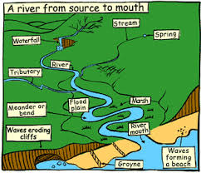
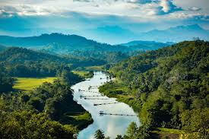

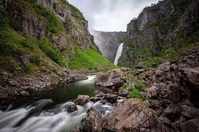


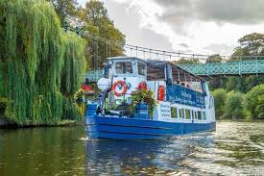
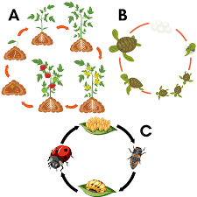
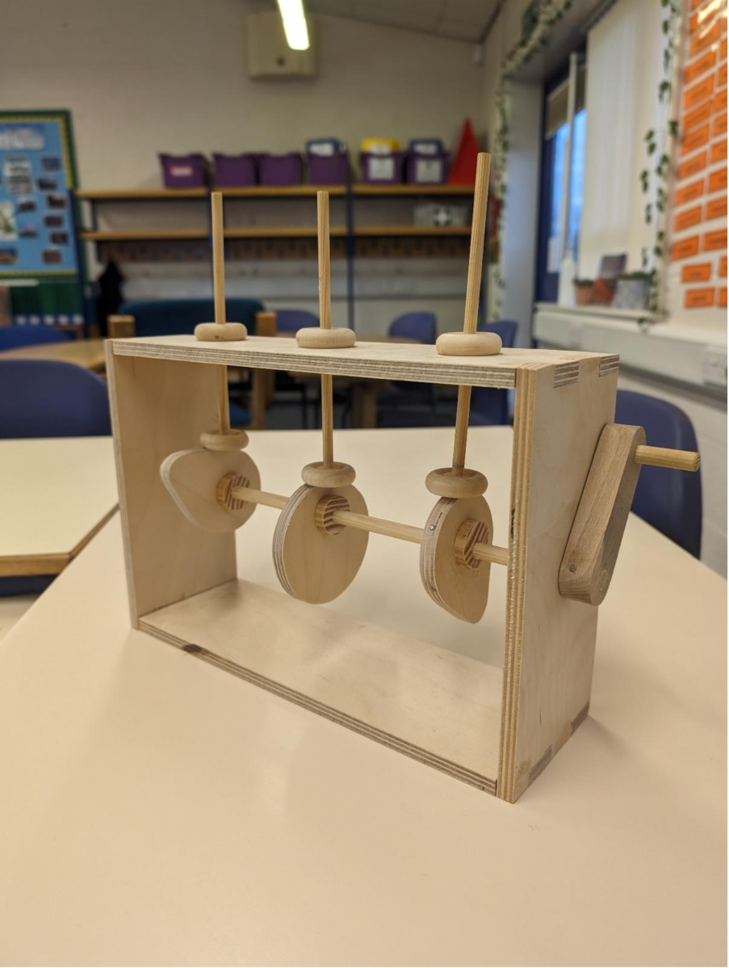
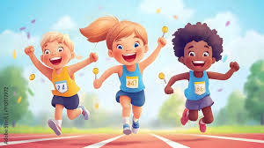
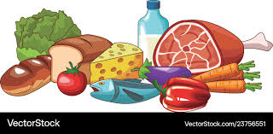

What are we learning about this half term?
Literacy/Guided Reading
Non-Fiction: Travel Writing
(Amazon Travel Guide)
Recount: Diary link to The Explorer
by Katherine Rundel.
Guided Reading
The Explorer by Katherine Rundel.
Year 5 Curriculum
2025-2026
Summer 1 - Rivers
Maths
Calculating fractions
Geometry: Position and Direction
Measurement:
Metric and Imperial
Volume
Computing
Creating Media: Vector
Drawing
Music
Shropshire Music Service will be in teaching children to play toots.
Charanga:
Classroom Jazz
Fresh Prince (singing focus)
Geography
Rivers
Life Learning (RSE)
Working World
Our World: Enterprise
PE
Indoor- Dance
Outdoor- Athletics
Trips
Shrewsbury
quarry for
the Sabrina
boat trip
Science
Living things and their
habitats – life cycles
DT
CAMS mechanisms
Websites we will be using:
TTRS Home - Times Tables Rock Stars
Google Drawing - docs.google.com/drawings
BBC learn BBC - Home
Charanga A world-leading, configurable music teaching and learning platform
One Decision PSHE, RSHE & Personal Development for KS1 & KS2
MFL
Topic: food
Religious Education:
For many Christians, how might following God bring freedom and justice?​

Slide 2
What are we learning about this half term?
Literacy/Guided Reading
Non-Fiction: Travel Writing
(Amazon Travel Guide)
Recount: Diary link to The Explorer
by Katherine Rundel.
Guided Reading
The Explorer by Katherine Rundel.
Year 5 Curriculum
2025-2026
Summer 1 - Rivers
Maths
Calculating fractions
Geometry: Position and Direction
Measurement:
Metric and Imperial
Volume
Computing
Creating Media: Vector
Drawing
Music
Shropshire Music Service will be in teaching children to play toots.
Charanga:
Classroom Jazz
Fresh Prince (singing focus)
Geography
Rivers
Life Learning (RSE)
Working World
Our World: Enterprise
PE
Indoor- Dance
Outdoor- Athletics
Trips
Shrewsbury
quarry for
the Sabrina
boat trip
Science
Living things and their
habitats – life cycles
DT
CAMS mechanisms
Websites we will be using:
TTRS Home - Times Tables Rock Stars
Google Drawing - docs.google.com/drawings
BBC learn BBC - Home
Charanga A world-leading, configurable music teaching and learning platform
One Decision PSHE, RSHE & Personal Development for KS1 & KS2
MFL
Topic: food
Religious Education:
For many Christians, how might following God bring freedom and justice?​

