Slide 1
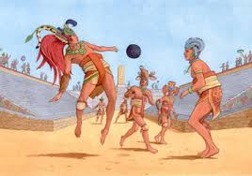
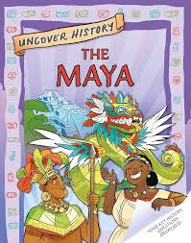
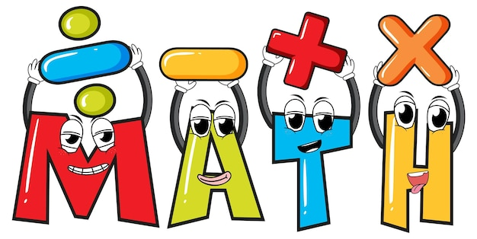
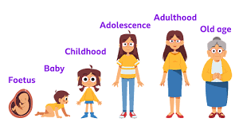
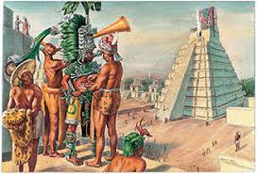
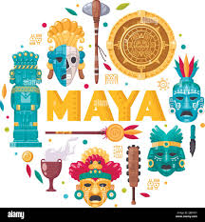

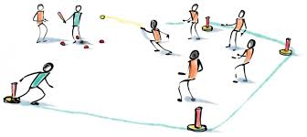
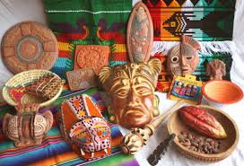
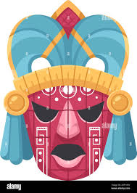

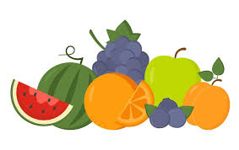
What are we learning about this half term?
Literacy/Guided Reading
Playscripts on the Explorer text
Narrative on Pok a tok – Maya sport
Guided Reading
The Great Kapok Tree by Lynne Cherry
(Amazon and Maya link)
Uncover the history the Maya
Year 5 Curriculum
2025-2026
Summer 2
Mayan Civilisation
Maths
Fractions: Decimals, percentages, calculating.
Geometry: Properties of shapes.
Statistics: Reading line graphs.
Roman Numerals.
Addition and subtraction.
Multiplication and Division
Science
Changes in humans as they grow
(Animals including humans)
History
Mayan Civilisation
Music
Shropshire Music Service will be in teaching children to play toots.
Charanga:
Fresh Prince (singing focus)
Computing
Vector drawings
Websites we will be using:
TTRS Home - Times Tables Rock Stars
BBC learn BBC - Home
Charanga A world-leading, configurable music teaching and learning platform
One Decision PSHE, RSHE & Personal Development for KS1 & KS2
Life Learning (RSE)
Growing and changing: Puberty, menstruation, reproduction and pregnancy.
Feelings and Emotions: Anger
PE
Indoor-
Dodgeball
Outdoor-
Rounders
Trips/ visitors
Maya workshop
(11th June)
Art
Maya masks - clay
MFL
Food likes and dislikes
Religious Education:
NATRE: What matters most to Humanists and Christians.

Slide 2
What are we learning about this half term?
Literacy/Guided Reading
Playscripts on the Explorer text
Narrative on Pok a tok – Maya sport
Guided Reading
The Great Kapok Tree by Lynne Cherry
(Amazon and Maya link)
Uncover the history the Maya
Year 5 Curriculum
2025-2026
Summer 2
Mayan Civilisation
Maths
Fractions: Decimals, percentages, calculating.
Geometry: Properties of shapes.
Statistics: Reading line graphs.
Roman Numerals.
Addition and subtraction.
Multiplication and Division
Science
Changes in humans as they grow
(Animals including humans)
History
Mayan Civilisation
Music
Shropshire Music Service will be in teaching children to play toots.
Charanga:
Fresh Prince (singing focus)
Computing
Vector drawings
Websites we will be using:
TTRS Home - Times Tables Rock Stars
BBC learn BBC - Home
Charanga A world-leading, configurable music teaching and learning platform
One Decision PSHE, RSHE & Personal Development for KS1 & KS2
Life Learning (RSE)
Growing and changing: Puberty, menstruation, reproduction and pregnancy.
Feelings and Emotions: Anger
PE
Indoor-
Dodgeball
Outdoor-
Rounders
Trips/ visitors
Maya workshop
(11th June)
Art
Maya masks - clay
MFL
Food likes and dislikes
Religious Education:
NATRE: What matters most to Humanists and Christians.

